Slide 1
Adaptive Gaze-Contingent
Rendering System
Real-Time Mitigation of Vergence-Accommodation Conflict
Patent Application — April 2026
Live Demo: gaze-focus-play.lovable.app
1 / 12

Slide 2
The Problem
Vergence-Accommodation Conflict (VAC)
Standard VR headsets present 3D content on a fixed focal plane
Eyes must converge (vergence) at virtual depth but focus (accommodate) at screen distance
This mismatch causes ocular fatigue, nausea, and discomfort
Software-based blur filters address symptoms, not the root cause
No existing system dynamically adjusts the physical focal plane in real-time
2 / 12

Slide 3
Objectives
Eliminate VAC
Sub-5ms Latency
Hardware-software bridge aligning physical focal plane with virtual depth in real-time
Bio-acoustic and neural data for predictive gaze-contingent rendering
Astigmatism Correction
Foveated Rendering
Asymmetric varifocal liquid lens with real-time personalised correction
Predictive saccadic vector computation for compute-efficient high-fidelity display
Multi-User Support
Interoperability
Synchronized gaze aggregation network for collaborative XR experiences
MGAD Universal Data Port for third-party VR/AR platforms
3 / 12

Slide 4
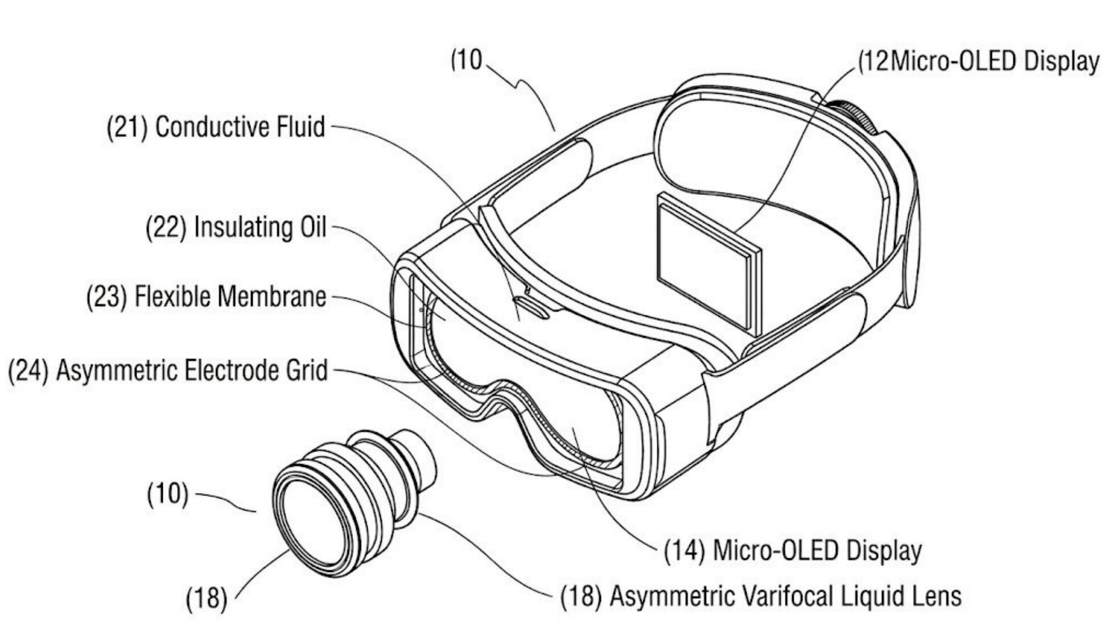
System Overview
10,000Hz Dual-Camera Eye Tracking
Asymmetric Electrode Liquid Lens (AELL)
Acoustic-Piston Varifocal Actuator
Predictive Look-Ahead Latency Algorithm
Neural-Intent Trigger (EEG + Ciliary)
Visual Comfort Profile (VCP) Mapping
FIG. 1 — Liquid Lens & Headset Architecture
4 / 12

Slide 5
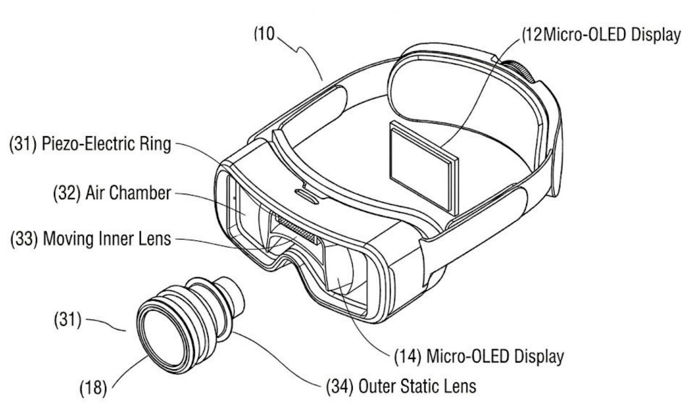
Headset Architecture
Liquid Lens Assembly (AELL)
Conductive fluid + insulating oil separated by flexible membrane. Asymmetric electrode grid applies differential voltages to reshape fluid interface — enabling dynamic focus AND real-time astigmatism correction.
Acoustic-Piston Actuator
Piezo-electric ring generates acoustic pressure pulses displacing inner lens relative to static outer lens. Achieves focal depth changes in sub-5ms.
FIG. 3 — Acoustic-Piston Varifocal Actuator
5 / 12

Slide 6
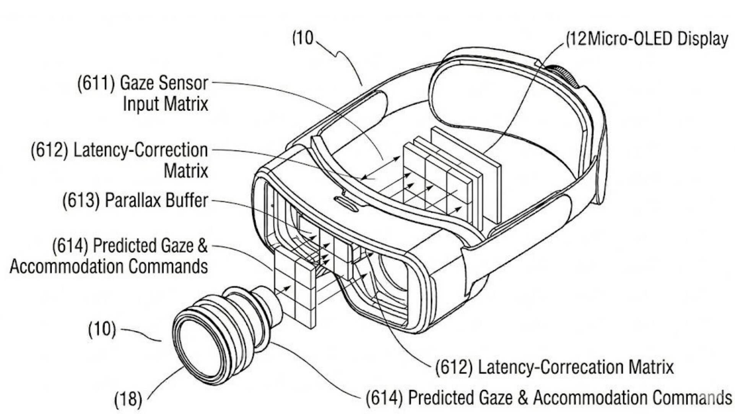
Gaze Tracking & Latency Prediction
Dual-Camera 10,000Hz Tracking
Binocular vergence computation — 3D intersection of both optical axes determines precise fixation depth.
Predictive Look-Ahead Algorithm
Gaze Sensor Input Matrix → Latency-Correction Matrix → Parallax Buffer → Predicted Gaze & Accommodation Commands dispatched before fixation.
FIG. 5 — Latency-Correction Matrix
6 / 12

Slide 7
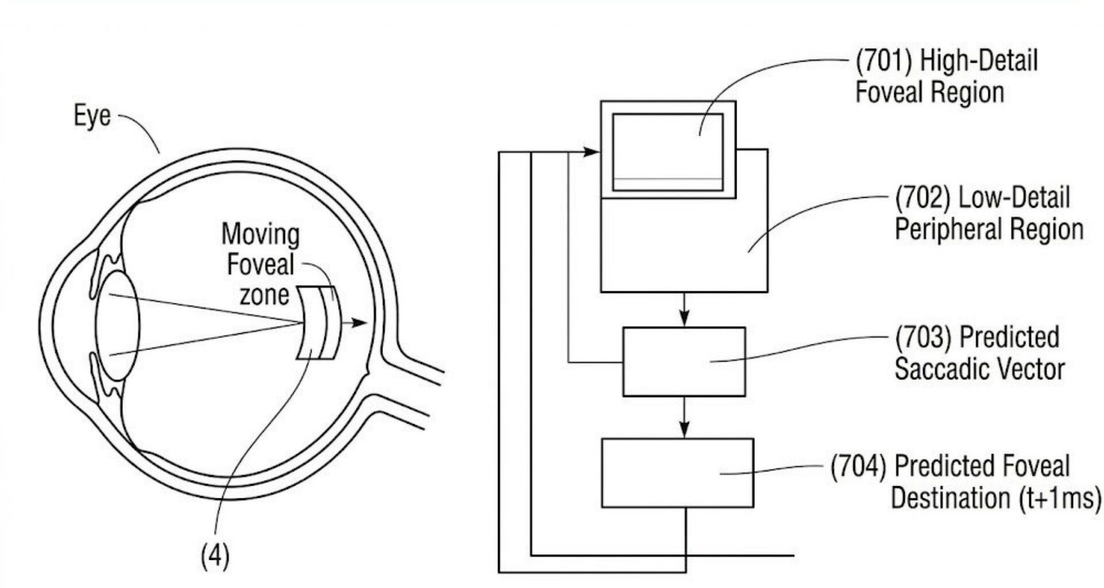
Foveated Rendering Engine
High-Detail Foveal Region vs Low-Detail Peripheral Region
Predicted Saccadic Vector anticipates next gaze landing point at t+1ms, enabling pre-emptive mesh detail allocation before saccade completion.
Result: seamless high-fidelity rendering without perceptible detail transitions, dramatically reducing GPU load.
FIG. 6 — Foveated Mesh & Saccadic Prediction
7 / 12

Slide 8
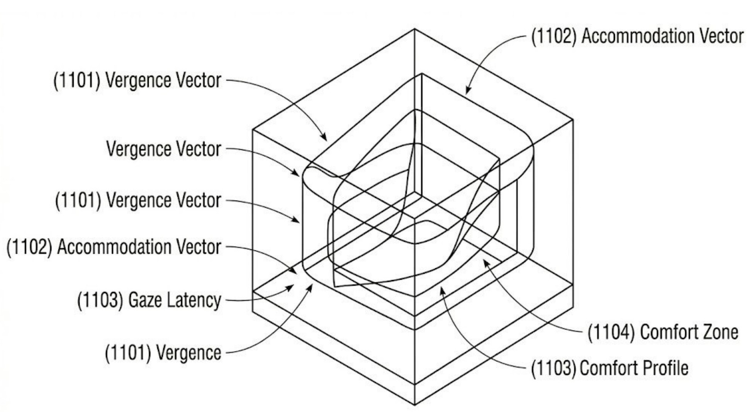
Neural-Intent & Visual Comfort
Neural-Intent Trigger (FIG. 8)
Fuses EEG alpha waves + ciliary muscle tension → Varifocal Pre-Activation signal fires before conscious gaze shift.
Visual Comfort Profile (FIG. 10)
3D comfort map: Vergence × Accommodation × Gaze Latency axes. System continuously monitors user state against personalised comfort boundaries.
FIG. 10 — VCP 3D Data Map
8 / 12

Slide 9
Multi-User & Bio-Acoustic Sensing
Collaborative Gaze Mapping (FIG. 11)
Multiple user gaze nodes → Sync Gaze Hub & Aggregator → Unified Gaze & Comfort Map. Rendering co-optimised across all participants.
Bio-Acoustic Sensors (FIG. 12)
Bone-conduction mics + skin-tap detectors on hand/wrist. Sub-dermal vibration paths carry ciliary muscle tension signals for predictive focal actuation.
MGAD Universal Data Port (FIG. 13)
Standardised interface: gaze power pins, high-speed differential pairs, gaze clock, latency-correction pin — enabling third-party interoperability.
9 / 12

Slide 10
Live Web Demo
gaze-focus-play.lovable.app
MediaPipe Face Mesh
Browser-based face tracking via webcam (WebRTC)
3-Zone Focus Simulation
Screen divided into left/center/right — focused zone clear, others blurred
Smoothed Tracking
Exponential smoothing + hysteresis thresholds prevent jitter
Real-Time Telemetry
FPS, confidence, face detection status, raw nose offset displayed live
Radial Spotlight
Gradient focus area moves smoothly with gaze direction
Built with React 18, Vite 5, Tailwind CSS, TypeScript — zero backend required
10 / 12

Slide 11
Key Patent Claims
10,000Hz binocular gaze tracking with <5ms varifocal response
Asymmetric Electrode Liquid Lens for focus + astigmatism correction
Acoustic-Piston Actuator for sub-5ms mechanical focal shift
Neural-Intent Trigger fusing EEG + bio-acoustic ciliary signals
Predictive Look-Ahead Latency Algorithm with parallax buffer
Gaze-aware foveated rendering with saccadic vector prediction
Visual Comfort Profile (VCP) personalised 3D mapping
Multi-user collaborative gaze aggregation network
MGAD Universal Data Port for third-party interoperability
11 / 12

Slide 12
Conclusion
By resolving Vergence-Accommodation Conflict at its physiological root through hardware-software co-design, this invention ensures natural ocular behaviour, significantly reduces fatigue, and enhances immersive presence in VR, AR, and mixed reality applications.
Applicable to surgical visualisation, professional simulation, and consumer XR.
10,000
<5
14
10
Hz Tracking
ms Latency
Figures
Claims
Thank You
12 / 12

